Slide 2
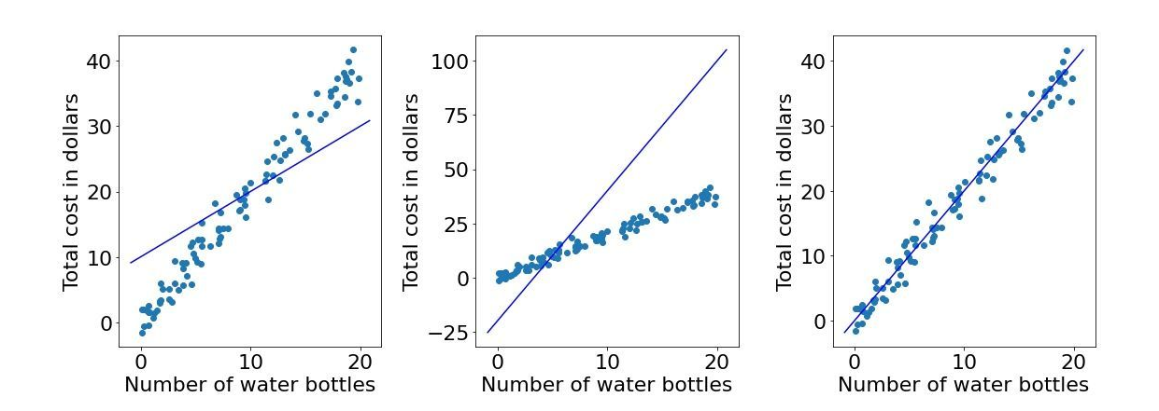
Question for Audience: "Based on the data points in each image, which predicted line best explains the underlying distribution? Consider factors like overall trend, spread, and alignment with data points."
Follow-up Points for Discussion:
How well does each line align with the general trend of the data points?
Does the line capture the spread of the data points effectively?
How would each line impact predictions for future data points?

Slide 3
The images show the linear regression line adjusting to fit data by minimizing loss on a convex curve. Initially, high error (loss) decreases as gradient descent iteratively optimizes the line's parameters, moving the tangent down the convex curve until the line best fits the data points with minimal loss.

Slide 4
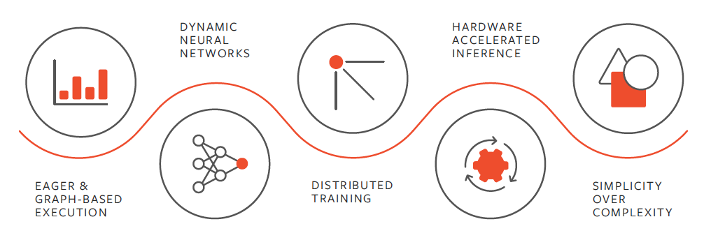
Why PyTorch? Tackling Complex Equations in Large-Scale Models
Handling Large Models: Modern models, like Large Language Models (LLMs), involve billions of parameters and require immense computational power to process complex equations and vast datasets efficiently.
Automatic Differentiation: PyTorch’s built-in autograd functionality enables efficient computation of gradients, essential for optimizing complex models with multiple layers and non-linear equations.
Hardware Acceleration: PyTorch leverages GPUs and TPUs, making it possible to process and train massive models at scale.
Dynamic Computational Graphs: PyTorch’s dynamic graphing enables flexibility, allowing researchers to modify architectures and debug in real-time—crucial for the iterative process of training large-scale models.
Community and Ecosystem: Supported by a robust ecosystem, PyTorch offers a wide array of libraries and tools for simplifying model development and deployment, accelerating the innovation process.

Slide 5
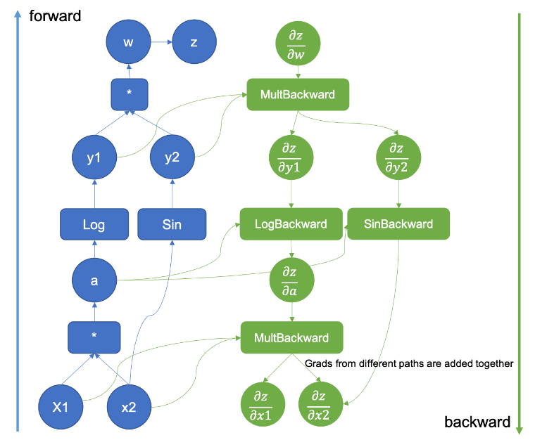
1.Introduction to PyTorch
Overview:
Open-source deep learning framework by Facebook AI, widely used in AI applications like computer vision, NLP, and reinforcement learning.
Popular for its intuitive, Pythonic interface, flexibility, and support in prototyping new models.
Comparison with TensorFlow & Keras:
TensorFlow: Strong for high-performance, scalable deployment but with a steeper learning curve.
Keras: Easy-to-use for quick prototyping, ideal for beginners; integrated with TensorFlow.
Core Features:
Dynamic Computation Graphs: Builds computation graphs on-the-fly, simplifying debugging and handling complex architectures.
Autograd: Automatic differentiation tool for backpropagation, useful in model optimization.
a = x1 * x2
y1 = torch.log(a)
y2 = torch.sin(a)
z = w * y1 + y2
Dynamic Computation Graph

Slide 6


Slide 7
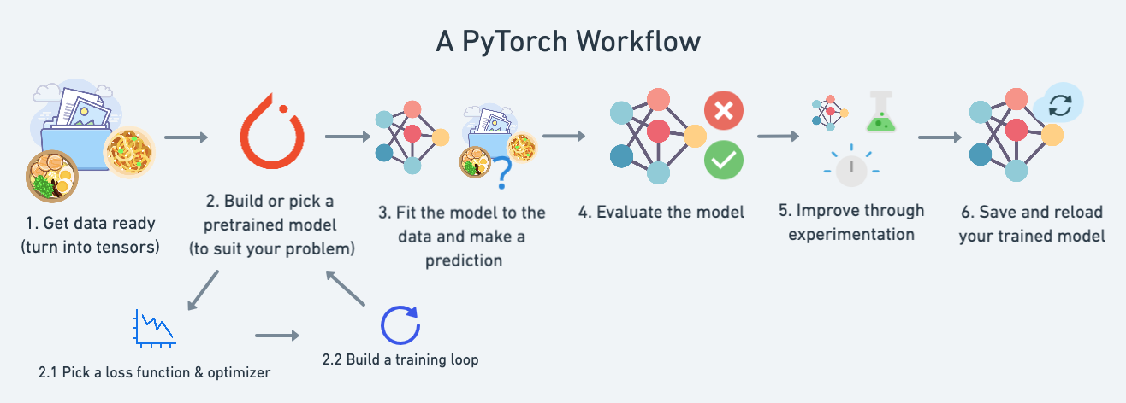

Slide 8
2. Tensor Basics and Matrix Operations
Understanding Tensors:
Tensors in PyTorch are multi-dimensional arrays, similar to NumPy arrays but with GPU support for accelerated computation.
Core structure for PyTorch data, allowing seamless GPU or CPU execution.
Tensor Operations:
Creation and Initialization: Various options (zeros, ones, random values, lists).
Reshaping and Slicing: Adapt tensors for model requirements.
Mathematical Operations: Addition, multiplication, and matrix operations.
Tensor Creation and Initialization torch.tensor(data): Create a tensor from data (e.g., list or NumPy array). torch.zeros(size): Create a tensor filled with zeros. torch.ones(size): Create a tensor filled with ones. torch.rand(size): Create a tensor with random values between 0 and 1. torch.randint(low, high, size): Create a tensor with random integer values in a range. torch.eye(size): Create an identity matrix. | Matrix Operations: torch.matmul(tensor1, tensor2): Matrix multiplication. tensor.mm(other): Matrix multiplication (alternative). tensor @ other: Matrix multiplication (Python syntax). torch.tensordot(tensor1, tensor2, dims): Generalized dot product. torch.outer(tensor1, tensor2): Outer product of two vectors. torch.dot(tensor1, tensor2): Dot product (for 1D tensors).

Slide 9
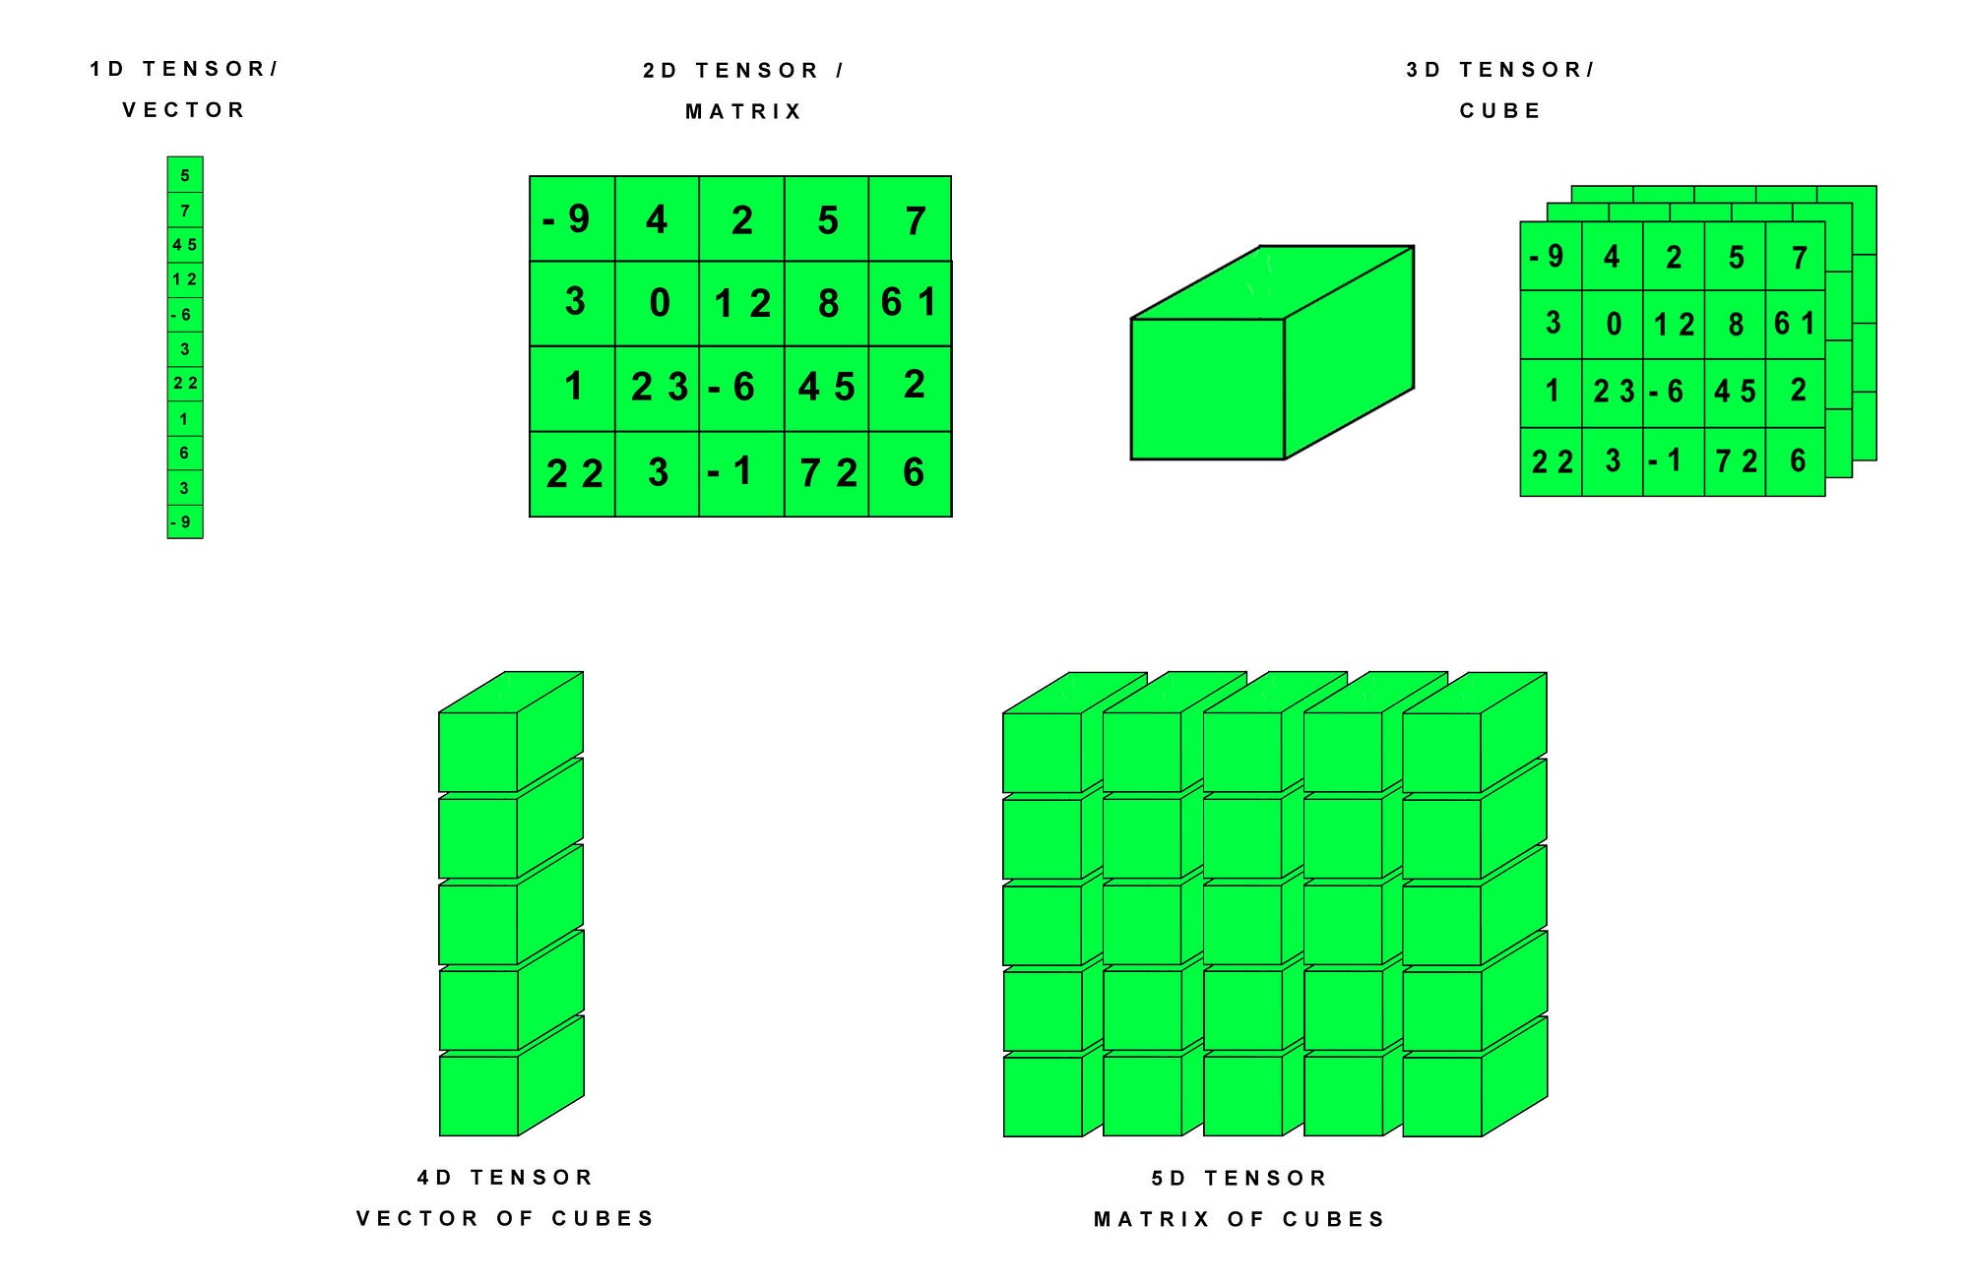

Slide 10
Tensor Shape Manipulation tensor.view(new_shape): Reshape a tensor. tensor.reshape(new_shape): Alternative for reshaping. tensor.unsqueeze(dim): Add a dimension (e.g., for batch processing). tensor.squeeze(dim): Remove a dimension (useful for single-batch data). torch.cat((tensor1, tensor2), dim): Concatenate tensors along a dimension. torch.stack((tensor1, tensor2), dim): Stack tensors along a new dimension. tensor.transpose(dim0, dim1): Swap two dimensions. tensor.permute(dims): Reorder dimensions. | Mathematical Operations Element-wise Operations: tensor + other: Addition tensor - other: Subtraction tensor * other: Multiplication tensor / other: Division tensor ** exponent: Exponentiation torch.sqrt(tensor): Square root torch.exp(tensor): Exponential function torch.log(tensor): Natural logarithm torch.abs(tensor): Absolute value torch.sin(tensor), torch.cos(tensor), torch.sigmoid(tensor), torch.relu(tensor): Activation functions
Indexing and Slicing tensor[index]: Standard indexing (similar to NumPy). tensor[:, start:end]: Slicing a tensor along dimensions. tensor.masked_select(mask): Select elements based on a boolean mask. torch.gather(tensor, dim, index): Gather specific elements along a dimension. | Statistical Operations torch.mean(tensor): Mean of all elements. torch.std(tensor): Standard deviation. torch.var(tensor): Variance. torch.corrcoef(tensor): Pearson correlation coefficient. torch.histc(tensor, bins): Histogram of values.

Slide 11
3. Data Handling in PyTorch
Dataset & Data Loader Classes:
Dataset: Provides standard methods for loading and processing data.
DataLoader: Allows batching, shuffling, and parallel data loading for optimized training.
Loading Custom Datasets:
Custom datasets can be created by subclassing Dataset to integrate unique data formats and preprocessing techniques.
Importance of Batching, Shuffling, and Parallel Loading:
Batching: Reduces memory usage, stabilizes training.
Shuffling: Prevents model from memorizing data order.
Parallel Loading: Speeds up training by efficiently loading data.
Dataset & DataLoader Classes torch.utils.data.Dataset torch.utils.data.DataLoader Loading Custom Datasets torchvision.transforms transforms.Compose transforms.ToTensor transforms.Resize transforms.Normalize transforms.RandomHorizontalFlip | Batching, Shuffling, and Parallel Loading batch_size (DataLoader argument) shuffle (DataLoader argument) num_workers (DataLoader argument) Additional Utility Functions torch.utils.data.random_split torch.cat / torch.stack torch.tensor torch.manual_seed

Slide 13
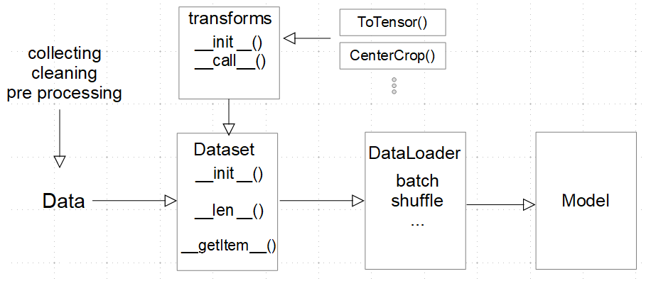

Slide 14
4. Building Neural Networks
Using nn.Module:
Layers and Activations: Fully connected layers using nn.Linear, nonlinear transformations (e.g., ReLU).
Architecture: Sequential layer design facilitates structured and complex model building.
Forward Pass and Activation Functions:
Activation Functions: Nonlinear layers like ReLU, Sigmoid add complexity to model capacity.
Forward Pass: Defines data flow through each layer, with transformations applied sequentially.
Using nn.Module Layers and Activations: torch.nn.Module torch.nn.Linear torch.nn.ReLU torch.nn.Sigmoid torch.nn.Tanh torch.nn.Softmax Architecture: torch.nn.Sequential | Forward Pass and Activation Functions forward (method for defining forward pass) Activation Functions: torch.nn.functional.relu torch.nn.functional.sigmoid torch.nn.functional.tanh torch.nn.functional.softmax

Slide 15
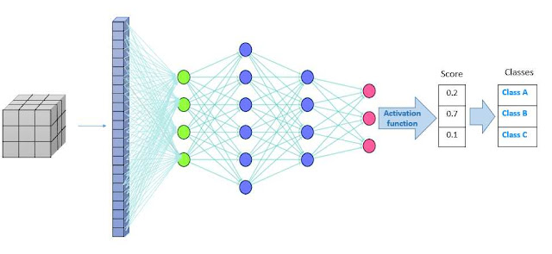

Slide 16
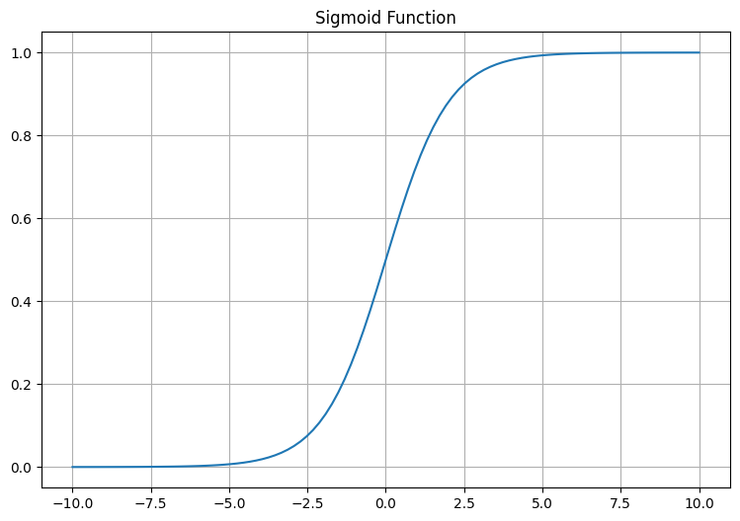
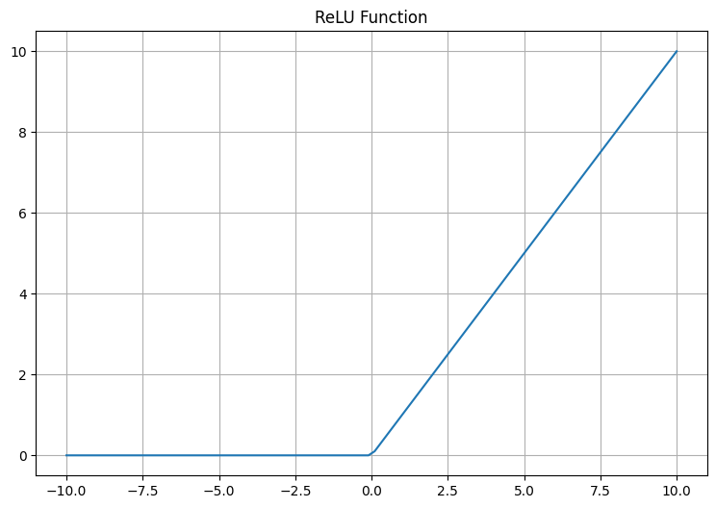
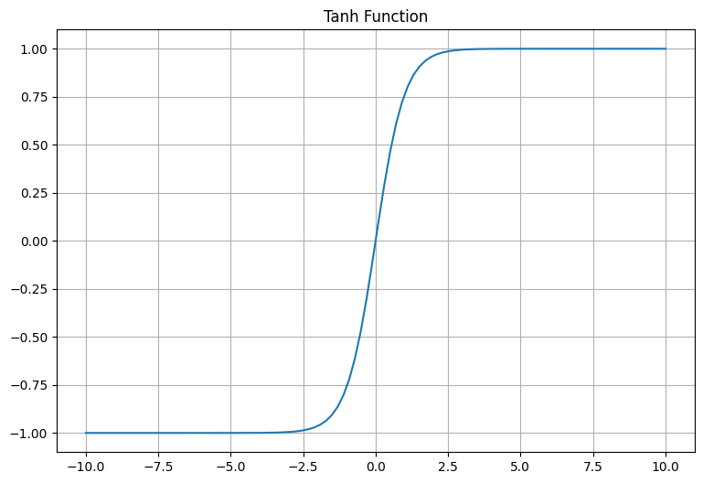
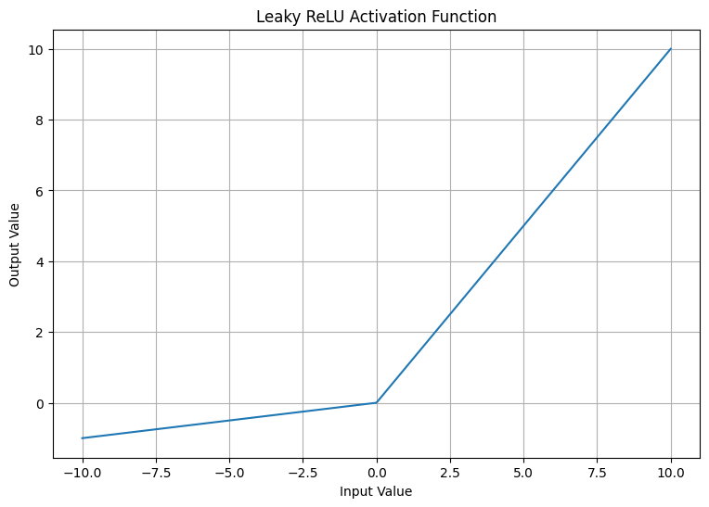
Main Activation Functions Overview
Sigmoid (Logistic)
Advantages: Smooth gradient, output between 0 and 1 (useful for binary classification).
Drawbacks: Vanishing gradient, not zero-centered.
Timeline: 1980s
ReLU (Rectified Linear Unit)
Advantages: Simple, fast convergence, helps with vanishing gradient.
Drawbacks: Dead neurons, unbounded.
Timeline: 2000s
Tanh (Hyperbolic Tangent)
Advantages: Zero-centered, smoother gradient than sigmoid.
Drawbacks: Vanishing gradient for large/small inputs.
Timeline: 1980s
Leaky ReLU
Advantages: Prevents dead neurons, retains ReLU benefits.
Drawbacks: Still unbounded, requires tuning of α\alphaα.
Timeline: 2010s

Slide 17
5. Training and Evaluation
Model Training:
Loss Functions: Quantify prediction accuracy (e.g., Cross-Entropy for classification).
Optimizers: (e.g., Adam, SGD) modify weights to minimize loss by adjusting in optimal directions.
Training Loop:
Epochs and Batches: Model weight updates over multiple epochs and batched data.
Example code: forward pass, loss computation, backpropagation, and parameter optimization.
Model Training Loss Functions: torch.nn.CrossEntropyLoss (for classification) torch.nn.MSELoss (for regression) torch.nn.BCELoss (for binary classification) torch.nn.NLLLoss (for negative log likelihood in classification) Optimizers: torch.optim.SGD (Stochastic Gradient Descent) torch.optim.Adam (Adaptive Moment Estimation) torch.optim.RMSprop | Training Loop Epochs and Batches: for epoch in range(num_epochs): (loop over epochs) for batch in data_loader: (loop over batches) Forward Pass, Loss, and Backpropagation: model(inputs) (forward pass) loss.backward() (compute gradients) optimizer.step() (update weights) optimizer.zero_grad() (reset gradients)

Slide 18
Optimizers:
SGD (Stochastic Gradient Descent)
Path: Red
Characteristics: Slow convergence; oscillates heavily near minima.
Momentum
Path: Green
Characteristics: Faster convergence than SGD; dampens oscillations by accumulating past gradients.
NAG (Nesterov Accelerated Gradient)
Path: Purple
Characteristics: Anticipates gradient direction; improves convergence over momentum by looking ahead.
Adagrad
Path: Blue
Characteristics: Adapts learning rate based on gradient history; suitable for sparse data but may decay learning rate too quickly.
Adadelta
Path: Yellow
Characteristics: Variant of Adagrad with decaying learning rate; helps retain performance over long training periods.
RMSprop
Path: Black
Characteristics: Similar to Adadelta; designed to handle non-stationary objectives by controlling gradient accumulation.
Notes:
Introduction: “On this slide, we have a GIF that visually demonstrates the behavior of different optimization algorithms as they attempt to reach the global minimum of a loss function, represented by the star. The black dot is the starting point, and each optimizer follows a unique path based on its characteristics. I’ll briefly go over each optimizer, its key features, and its pros and cons as seen in this visualization.”
1. SGD (Stochastic Gradient Descent): “As you can see, the red line represents Stochastic Gradient Descent, or SGD. SGD is a very basic optimizer that takes steps in the direction of the gradient of the loss function. While it's widely used, you’ll notice it has a slow convergence rate here and oscillates a lot near the minima. This oscillation happens because it takes each step only based on the current gradient, without any memory of past steps. This makes SGD less stable and inefficient for complex loss landscapes.”
2. Momentum: “Next, the green line represents Momentum. Momentum addresses one of SGD’s main issues by accumulating a fraction of the past gradients to ‘smooth’ the updates. This results in faster convergence and reduces oscillations, as it builds up speed in consistent gradient directions while dampening directions with high oscillations. In the GIF, you can see that Momentum reaches the minima faster than plain SGD while having a smoother path.”
3. NAG (Nesterov Accelerated Gradient): “The purple line represents NAG, or Nesterov Accelerated Gradient. NAG is similar to Momentum but with a significant improvement. It looks ahead to where the parameters would be if we continued on the current path and calculates the gradient at that point. This anticipation helps NAG adjust its direction more intelligently. You’ll notice in the GIF that NAG converges even faster and has a smoother trajectory, making it more efficient than Momentum in many cases.”
4. Adagrad: “The blue line represents Adagrad, an adaptive optimizer that adjusts the learning rate for each parameter individually. It’s beneficial for sparse data because it gives frequent features a lower learning rate and rare features a higher learning rate. However, you can see in the GIF that Adagrad’s steps get progressively smaller as it approaches the minimum. This is because it accumulates the square of gradients over time, which can decay the learning rate too quickly, slowing down convergence after a point.”
5. Adadelta: “Adadelta, shown in yellow, builds on Adagrad by introducing a decay factor to prevent the rapid drop in learning rate. This allows Adadelta to keep updating the parameters without the learning rate decaying to zero. In the visualization, you can see that Adadelta retains a relatively stable path and avoids the pitfalls of Adagrad’s overly reduced learning rate.”
6. RMSprop: “Finally, the black line represents RMSprop. RMSprop is another adaptive optimizer similar to Adadelta, but it’s explicitly designed for non-stationary objectives, like neural networks. RMSprop divides the learning rate by an exponentially decaying average of squared gradients, which gives it a more consistent and balanced path. In the GIF, you can see that RMSprop adapts well to the curvature of the loss landscape, achieving stable and quick convergence.”
Summary: “Overall, this comparison highlights how the choice of optimizer affects both the speed and stability of convergence in neural networks. SGD is simple but slow and unstable. Momentum and NAG improve on this by adding memory of past gradients, with NAG showing faster convergence. Adagrad, Adadelta, and RMSprop adapt the learning rate based on the gradient history, which can be beneficial for certain types of data. Choosing the right optimizer can depend on the specific problem, data, and model architecture.”

Slide 19
6. Model Evaluation
Evaluation Metrics:
Accuracy: Measures overall prediction correctness.
Precision, Recall, F1 Score: Essential for imbalanced datasets; assess specific types of prediction errors.
Evaluation Metrics
Accuracy:
torch.argmax(predictions, dim=1) (to get predicted class)
Precision, Recall, F1 Score:
sklearn.metrics.precision_score (requires scikit-learn)
sklearn.metrics.recall_score (requires scikit-learn)
sklearn.metrics.f1_score (requires scikit-learn)
sklearn.metrics.accuracy_score (for accuracy calculation)

Slide 20
